Slide 1



COMMUNITY DEVELOPMENT BLOCK GRANT
CARES FUNDING
INFORMATIONAL SESSION
JULY 28, 2020

Slide 2
OVERVIEW
1st wave of CDBG CARES funding - $20.5 Million
Prevent, prepare for, and respond to COVID-19
Agenda Items:
  Allocation Formula
  Eligible Expenses
  Program Guidelines
  Reimbursement Process
  Next Steps

Slide 3
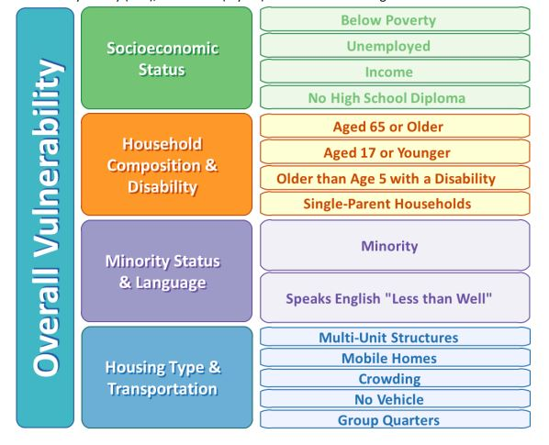
Allocation Formula
60% - Center for Disease Control’s Social Vulnerability Index.
40% - Aggregate count of approved unemployment insurance (UI) claims for week less the aggregate count of UI claims during the same time period last year.
15% modifier - Per capita rate of confirmed coronavirus cases.
(60%*SVI + 40%*UI Claims) + 15%*COVID-19 Cases = Weighted Score*
*This weighted score is then ranked to establish the allocation amount.
Notes:
ending 4/25/2020 – 5/30/2020
(week ending 4/27/2019 – 6/1/2019)

Slide 4
EXAMPLES OF ELIGIBLE EXPENSES
Health Care Equipment
Public Services
Salaries
Purchasing and distributing personal protective equipment (PPE).
Purchase of sanitation equipment.
Purchase of telehealth equipment to allow assisted residents access to health care providers from home.
COVID-19 testing costs
Setup of quarantine sites.
Assist vulnerable populations in accessing food, medical care or prescriptions.
Providing units for temporary quarantine purposes.
Emergency housing for health care workers.
Reimbursement for overtime costs for staff time related to COVID-19 response including hazard pay.
Hazard pay for essential workers that are managing or maintaining units, or staffing emergency or isolation units (County Sheriff or EMT).

Slide 5

Program Guidelines
Reimburse expenses dating back to January 21st, 2020, Grant to Close by December 31st 2020.
Reimburse unbudgeted expenditures to prevent, prepare for, and respond to coronavirus.
May reimburse eligible expenses incurred on behalf of or by eligible Local Units of Government within their jurisdiction.
Reimbursement of General government expenses is not eligible.
Duplication of Benefit: CDBG funds will not be used to reimburse for, or to fund, activities that received funding from another source. (FEMA, DHHS, etc.)

Slide 6
Reimbursement Process
Financial Management Summary
8-A Payment Request for County Allocation
  Invoice Summary
Financial Monitoring and Auditing
  State Program Audits
  HUD Audits

Slide 7
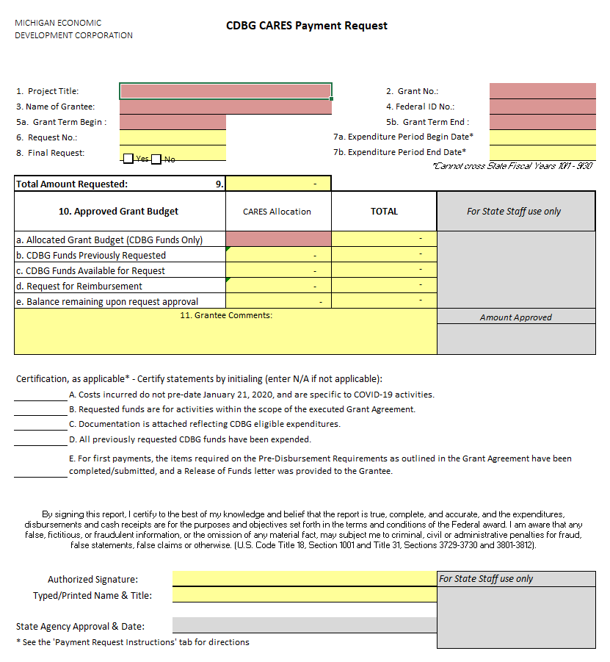
Reimbursement Process – Payment Request

Slide 8
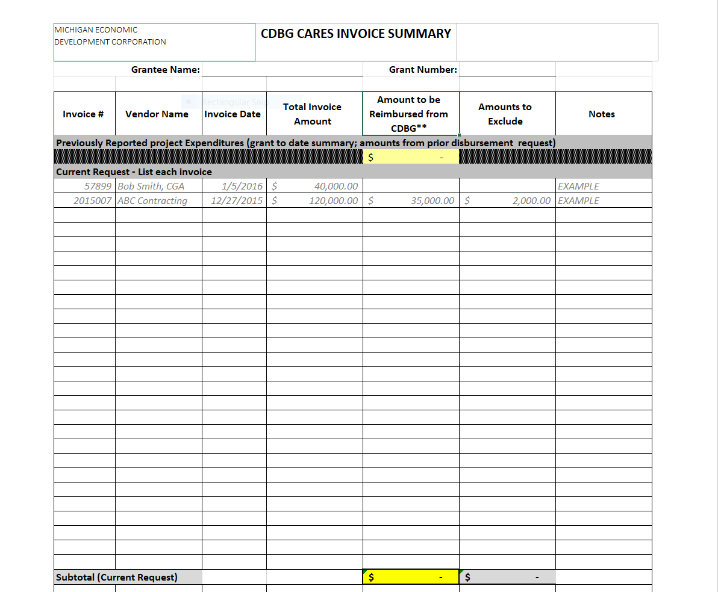
Reimbursement Process – Invoice Summary

Slide 9

NEXT STEPS
Acceptance/Denial Letter
  Grantee Identification
Assigned CDBG Specialist
CDBG Due Diligence
  Eligible Cost Review
  Environmental Review
Grant Agreement
  Grantee Acknowledgement
  Statement of Assurances & Certifications
  Pre-Disbursement Requirements

Slide 10
QUESTIONS?

Slide 11


