Slide 1



Community Development Block Grant (CDBG) Program Application Training
To start the audio/video presentation, please push F5 key on keyboard or select “Slide Show” (top center of screen) and click “From Beginning” button (left side).
To start the audio/video presentation, please push F5 key on keyboard or select “Slide Show” (top center of screen) and click “From Beginning” button (left side).
To start the audio/video presentation, please push the F5 key on keyboard or select “Slide Show” (top center of screen) and click “From Beginning” button (left side)

Slide 2

Project including Blight Elimination
IMPORTANT RESOURCE: CDBG FUNDING GUIDE
Every potential applicant must review the CDBG Funding Guide
Funding Guide outlines programmatic, operational, and compliance requirements
https://www.miplace.org/programs/community-development-block-grant/

Slide 3
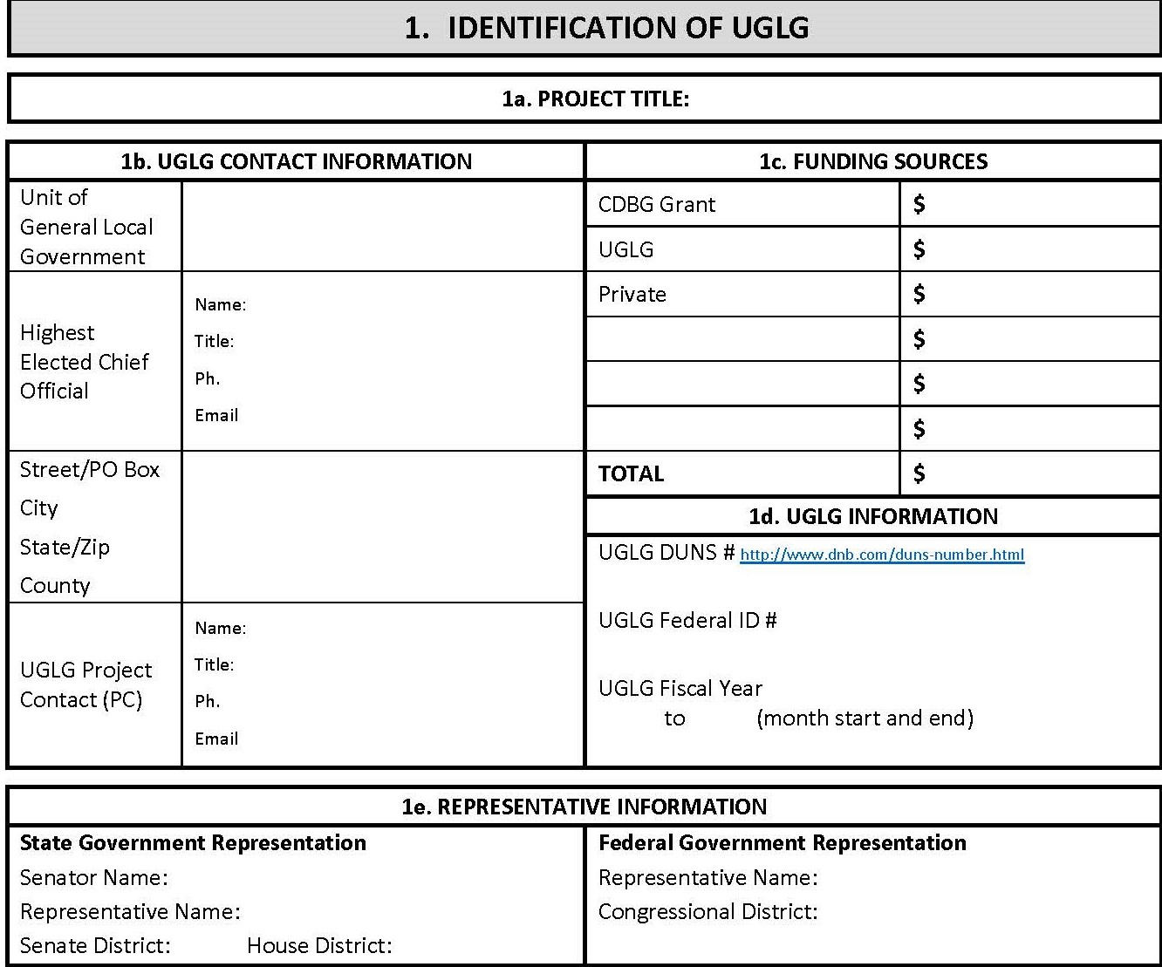
Project including Blight Elimination
SECTION 1: IDENTIFICATION OF UGLG
1a. PROJECT TITLE:

Slide 4
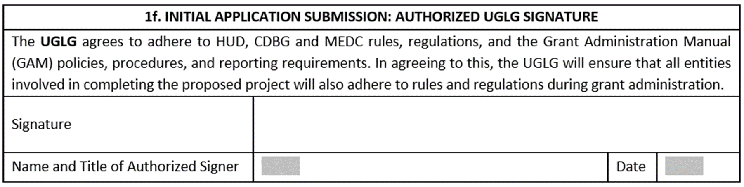
Project including Blight Elimination
SECTION 1: IDENTIFICATION OF UGLG
1a. PROJECT TITLE:

Slide 5
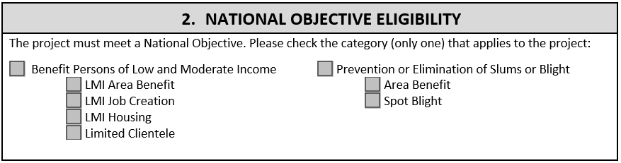
SECTION 2: NATIONAL OBJECTIVE

Slide 6
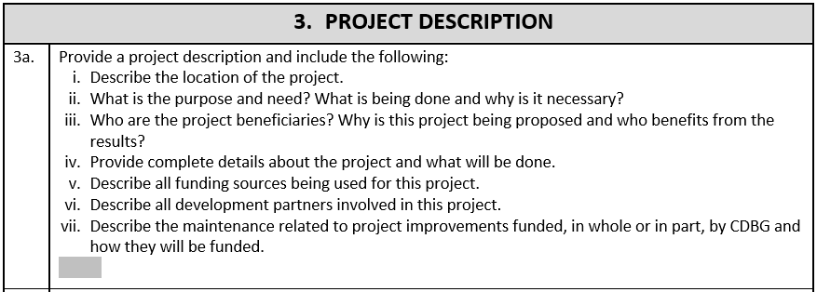
SECTION 3: PROJECT DESCRIPTION

Slide 7
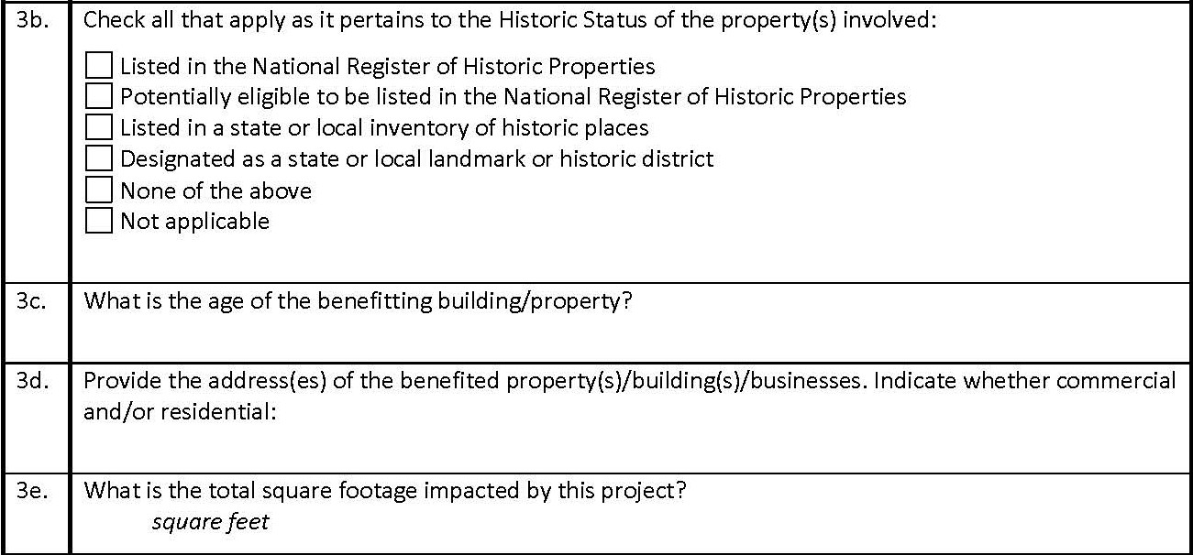
SECTION 3: PROJECT DESCRIPTION

Slide 8
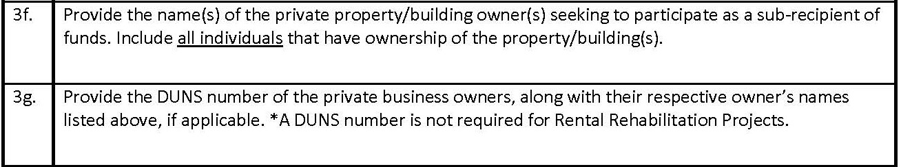
SECTION 3: PROJECT DESCRIPTION

Slide 9
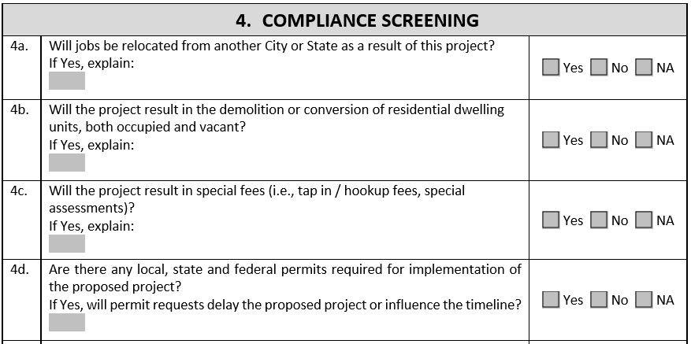
SECTION 4: COMPLIANCE SCREENING

Slide 10
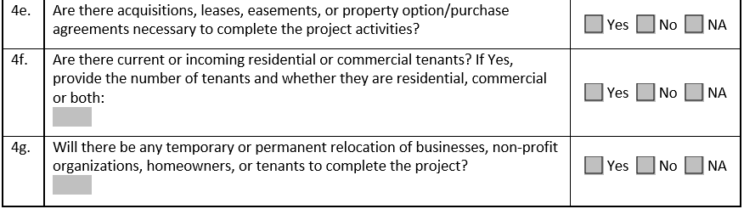
SECTION 4: COMPLIANCE SCREENING

Slide 11
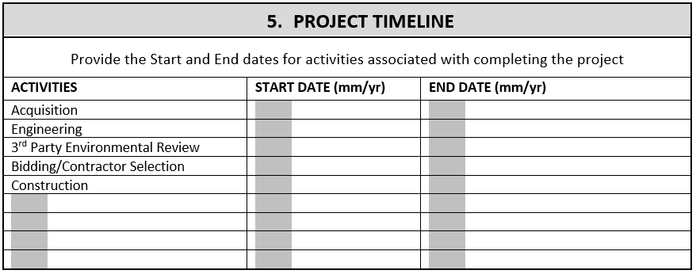
SECTION 5: PROJECT TIMELINE

Slide 12
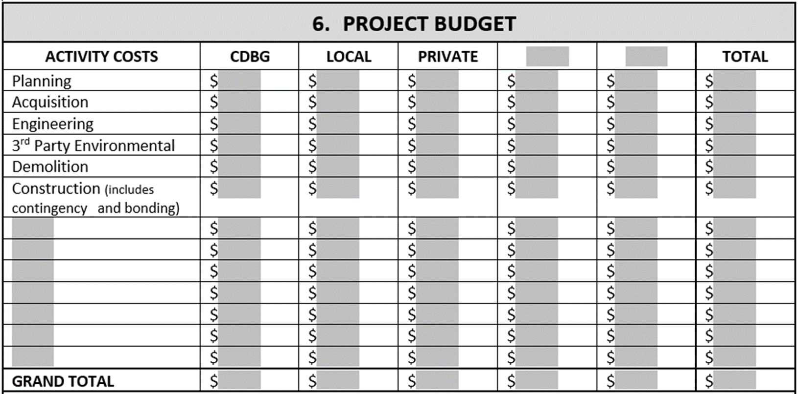
SECTION 6: PROJECT BUDGET

Slide 13
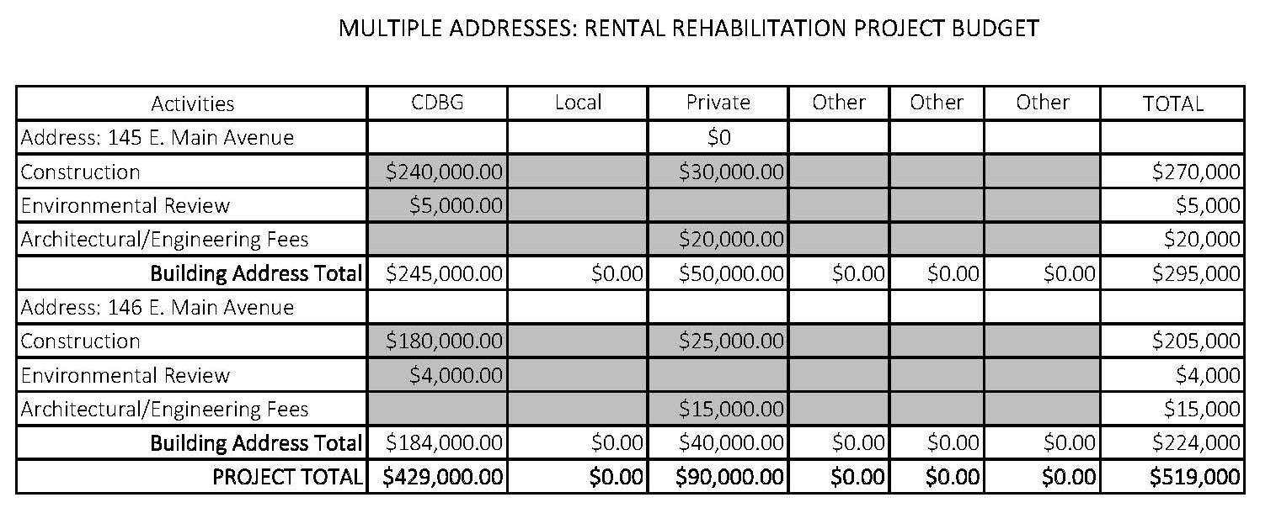
SECTION 6: SAMPLE RENTAL REHABILITATION PROJECT WITH MULTIPLE ADDRESSES

Slide 14
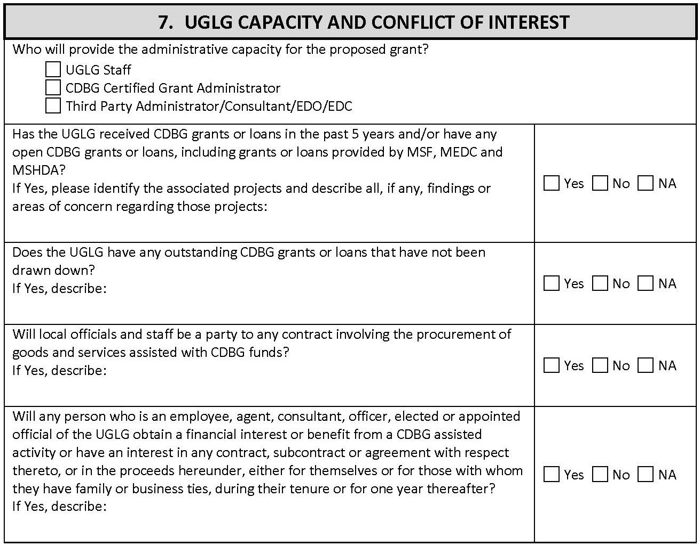
SECTION 7: UGLG CAPACITY & CONFLICT OF INTEREST

Slide 15
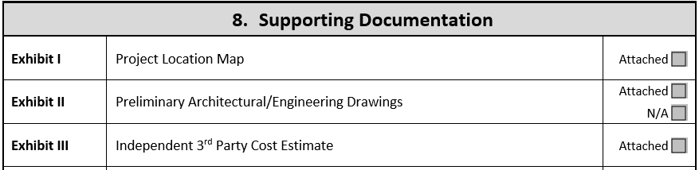
SECTION 8: REQUIRED SUPPORTING DOCUMENTATION

Slide 16
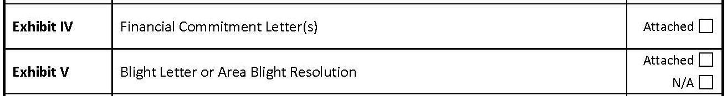
SECTION 8: REQUIRED SUPPORTING DOCUMENTATION

Slide 17
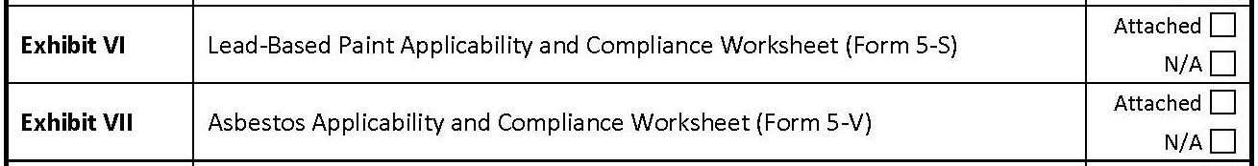
SECTION 8: REQUIRED SUPPORTING DOCUMENTATION

Slide 18
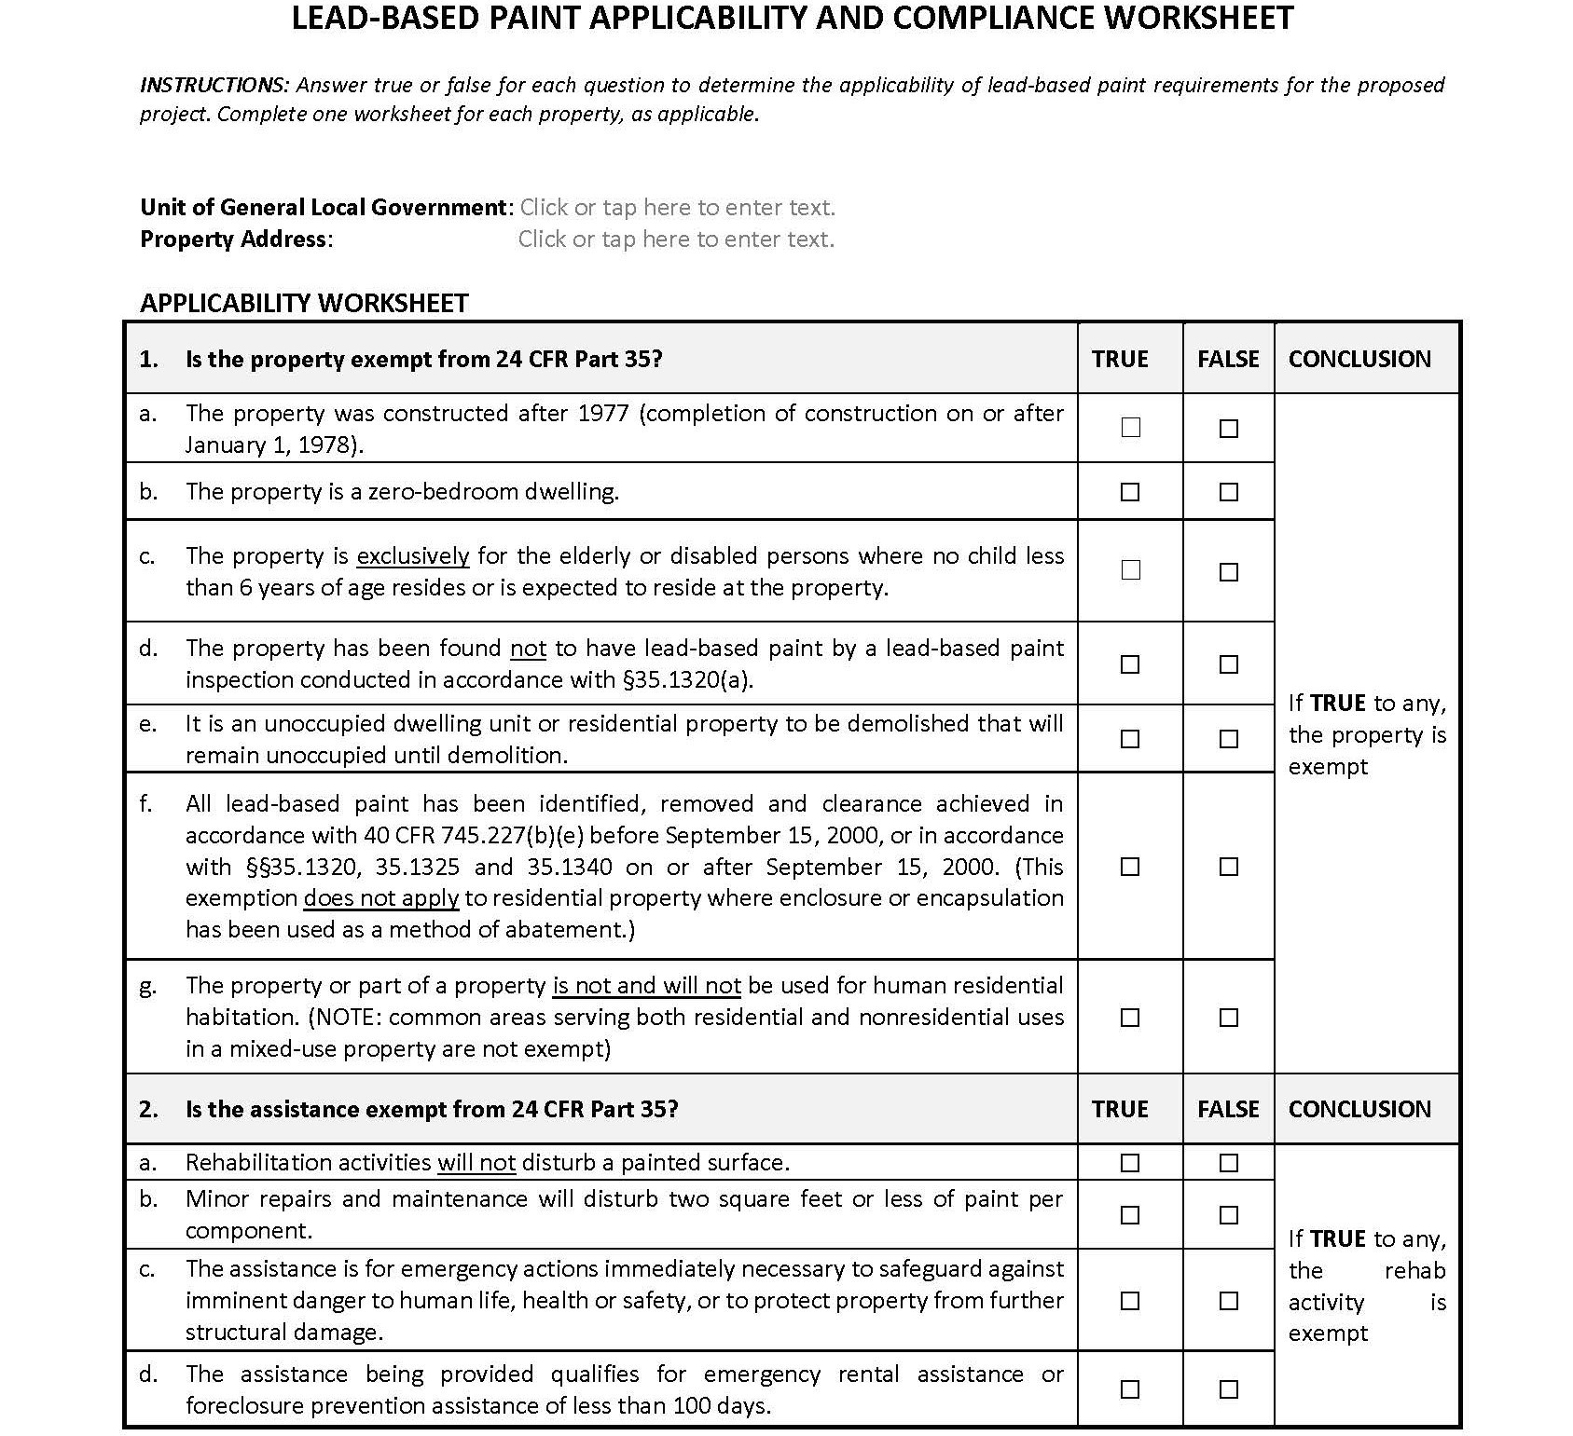
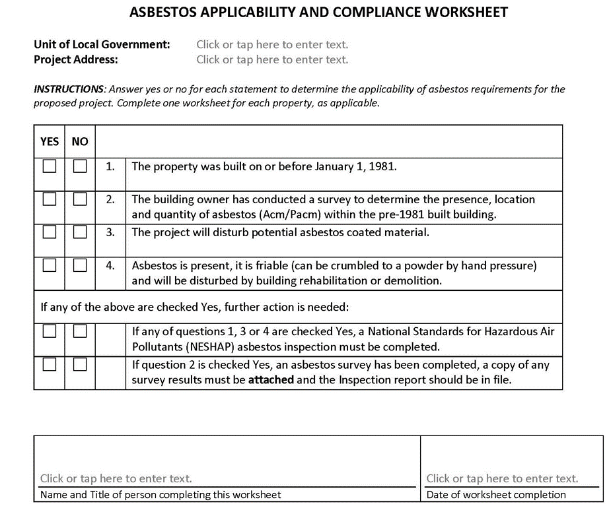
LEAD PAINT AND ASBESTOS WORKSHEETS

Slide 19
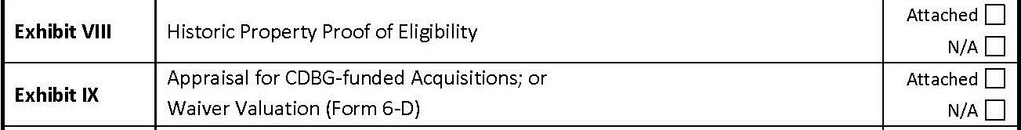
SECTION 8: REQUIRED SUPPORTING DOCUMENTATION

Slide 20
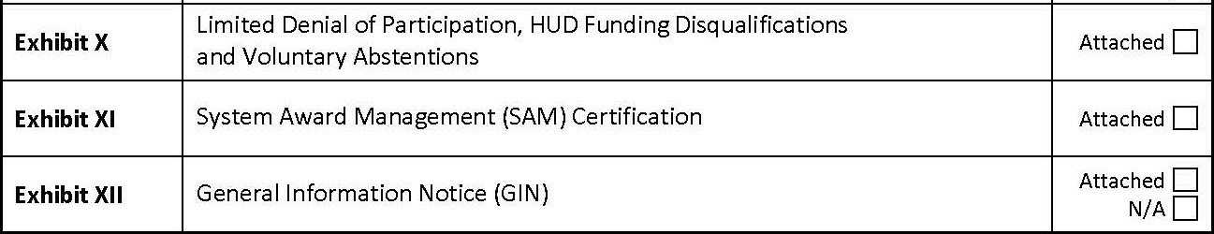
SECTION 8: REQUIRED SUPPORTING DOCUMENTATION

Slide 21
ADDITIONAL RESOURCES
Link to the CDBG Application, Application Instructions, Funding Guide, and General Administration Manual (GAM):
https://www.miplace.org/programs/community-development-block-grant/

Slide 22


