Slide 1
MATCH ON MAIN
FY25 FUNDING ROUND
SMALL BUSINESS SERVICES

Slide 2
What is Match on Main
Match on Main is a reimbursement grant program provided by the Michigan Economic Development Corporation (MEDC). It supports new or expanding place-based businesses by offering up to $25,000 in funding.
Applications submitted, administered, and managed by the local unit of government, downtown development authority, or other downtown management or community development organization where the business is located.
The grant applicant—representing a community that is an Essentials or Certified Redevelopment Ready Community® or a Select or Master Level Michigan Main Street Community

Slide 3
Match on Main Program Impact
SINCE 2019:
Over 500 applications submitted
196 businesses supported
91% of the businesses awarded since 2019 are still in business
Nearly 400,000 sq. ft. of vacant or underutilized space activated
428 full-time jobs created

Slide 4
Important Dates
Application Window Opens - Monday, January 20, 2025
Application Window Closes - Monday, April 7, 2025
Awardees Announced - Thursday, June 26, 2025
Grant Agreements Executed - September 2025
Projects must be completed within 12 months of the Grant Agreement.
Grant award payments will be made following project completion and after the MEDC receives the required materials as outlined in the grant agreement.
Payment will be made 6 - 8 weeks after the disbursement has been requested.

Slide 5
Eligible Small Businesses
Located within the boundaries of the community the Eligible Applicant serves
Sell products and/or services face-to-face, have a permanent physical location within the eligible community, have control over the site for which they are applying prior to MoM application
Operating as a for profit or non-profit
Headquartered in Michigan
Meet the ten percent (10%) cash match required as part of this program

Slide 6
Small Business Selection
Does the proposed project:
Align with the goals of the community/downtown
Improve the local area for residents and visitors
Introduce innovative or creative elements and dynamic space
Have the potential to attract visitors or enhance community engagement
Does the business:
Demonstrate business stability and operational history
Show projected revenue growth post-project
Provide evidence of project viability
The business owner should be prepared to manage project costs initially, as grant funds will be provided after the project is completed and the necessary documentation is submitted.

Slide 7
Calculating the 10% Match
The business owner is requesting $25,000 in grant dollars:
$25,000 x .10 = $2,500 in Match Dollars
$25,000 + $2,500 = $27,500 in identified eligible expenses
The business owner is requesting $18,000 in grant dollars:
$18,000 x .10 = $1,800 in Match Dollars
$18,000 + $1,800 = $19,800 in identified eligible expenses

Slide 8
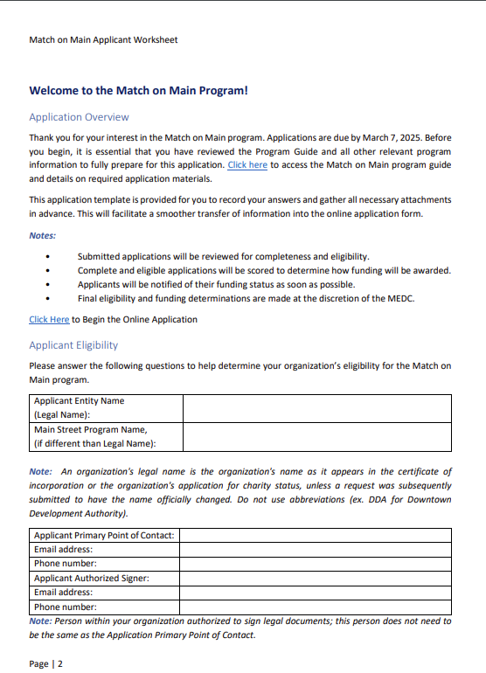
Applicant Worksheet
The completed application has two parts: information from the local community (Applicant) and information from the local small business.

Slide 9
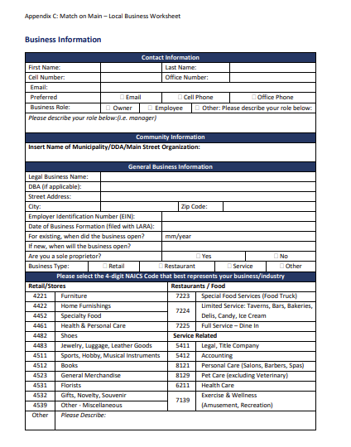
Local Business Worksheet
The local business worksheet requests information from the local small business. It contains basic informational questions, narrative questions and a projected budget.
Tip: The Applicant and the Small Business selected should work together on the application to ensure all criteria and evaluation considerations are met.

Slide 10
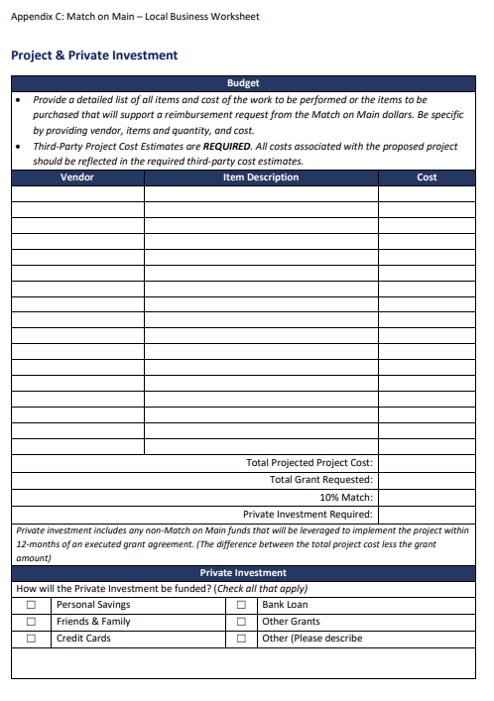
Budget
The Local Business Worksheet provides a budget page that is critical to the success of the project.
Provide a detailed list of all items and cost of the work to be performed or the items to be purchased that will support a reimbursement request from the Match on Main dollars. Be specific by providing vendor, items and quantity, and cost.
Third-Party Project Cost Estimates are REQUIRED. All costs associated with the proposed project should be reflected in the required third-party cost estimates
Tip: Ensure that to provide information about how you will fund the project prior to receiving the grant and the gap between the awarded amount and the total cost of the project (if any).

Slide 11
Calculating Project & Private Investment
A boutique retailer plans to broaden their offerings by adding new product lines, requiring an investment of $27,500 in inventory. To finance this, they intend to apply for the maximum $25,000 grant available from MoM, contributing a 10% match ($2,500) from their funds. The application should include $27,500 in validated quotes from suppliers as proof of the planned expenditure. In this case the Private Investment would be $2,500.
Total MoM Grant Sought (including 10% match)
Total expenses not covered by the grant
Total Project Cost
MoM Grant Request
Total Private Investment
$27,500
$0
$ 27,500
$25,000
$2,500

Slide 12
Ready for Submission?
Applicants are encouraged to use the provided templates and gather all necessary attachments (see the list below) before starting the online submission process.
Online application will be available at: www.miplace.org/small-business/match-on-main beginning January 20, 2025
The applications ask informational and narrative questions about the applicant organization and narrative questions about the project and the local small business.
The application requires several attachments including:
Applicant and local business worksheets,
Before photos (a minimum of 3) of the project,
Third-party cost estimates,
Business plan (optional for existing businesses, required for businesses open less than a year or startups).

Slide 13
MEDC Review
Applicant Evaluation Considerations
History of administrative track record of past MoM grant management
History of supporting businesses within the district where the eligible business is located
Alignment of selected business and proposed project with mission, vision and/or strategic priorities of the applicant organization
Demonstrated administrative capacity and plan for program management
Transparency of process used to select the business included in the Match on Main application
Small Business Evaluation Considerations
Clarity and completeness of project scope documentation, including cost estimates and budget
Private investment by the selected business
Additional resources leveraged to support the business and/or proposed project
Impact Match on Main funds will have on the selected business
Availability of private sources funding to implement project prior to Match on Main grant reimbursement
Additional considerations may include the geographic distribution of funds across state regions and the location of eligible businesses in disadvantaged areas, as defined by State Opportunity Zones or HUB Zones.

Slide 14
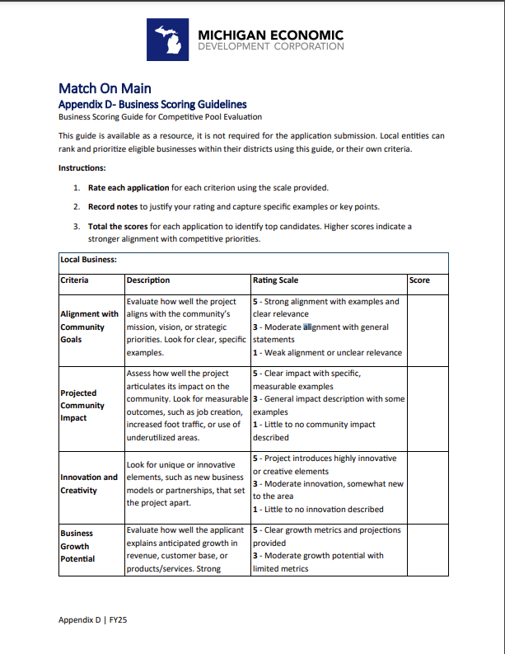
RESOURCES
Additional Information
Visit our website at https://www.miplace.org/small-business/match-on-main/
Match on Main Program User Guide
Appendix A: Program Fact Sheet
Appendix B: Applicant Worksheet
Appendix C: Local Business Worksheet
Appendix D: Business Scoring Guidelines
Appendix E: Grant Disbursement & Final Report Form
Appendix F: Timeline
Appendix G: MSF Background Certification
Exhibit A: Program Guidelines
Previous Match on Match Grant Awardees

Slide 15
The Michigan Economic Development Corporation is the state’s marketing arm and lead advocate for business development, job awareness and community development with the focus on growing Michigan’s economy.
Notes:
Insert your contact information

